Slide 1





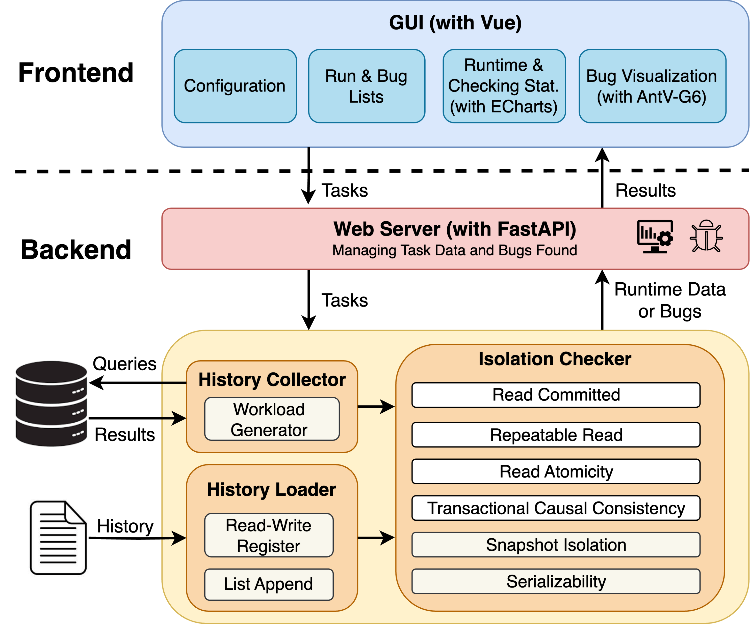

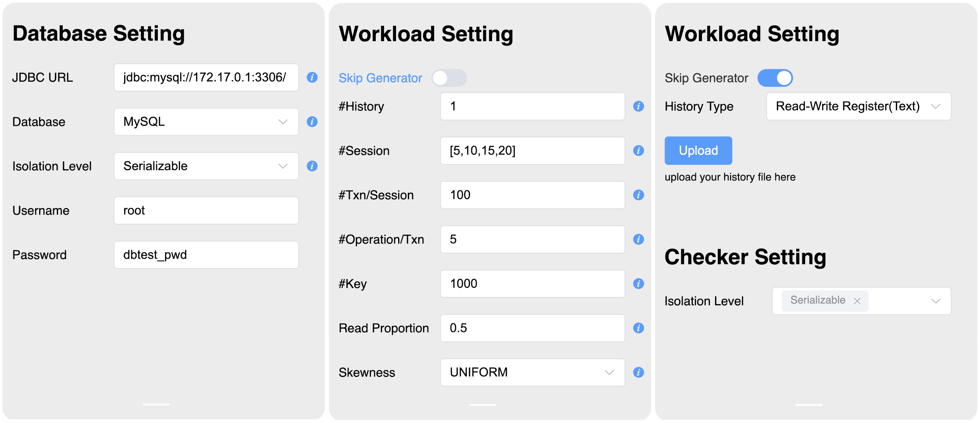
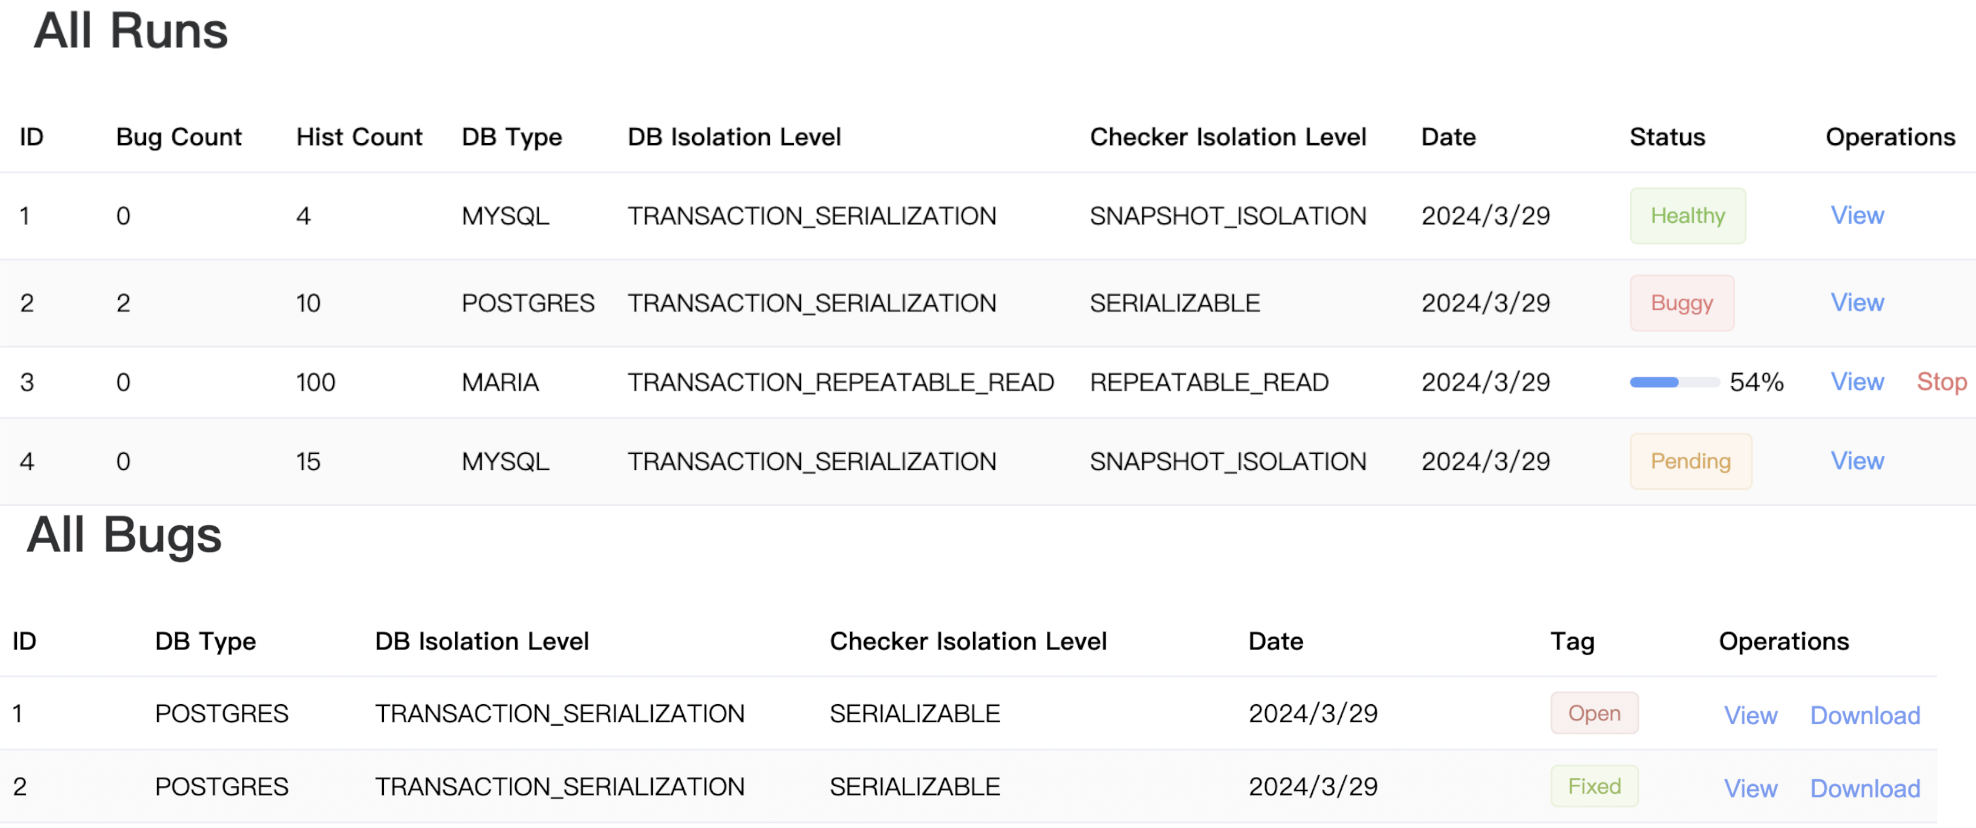
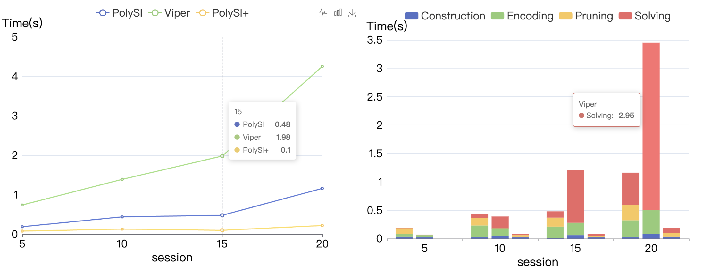
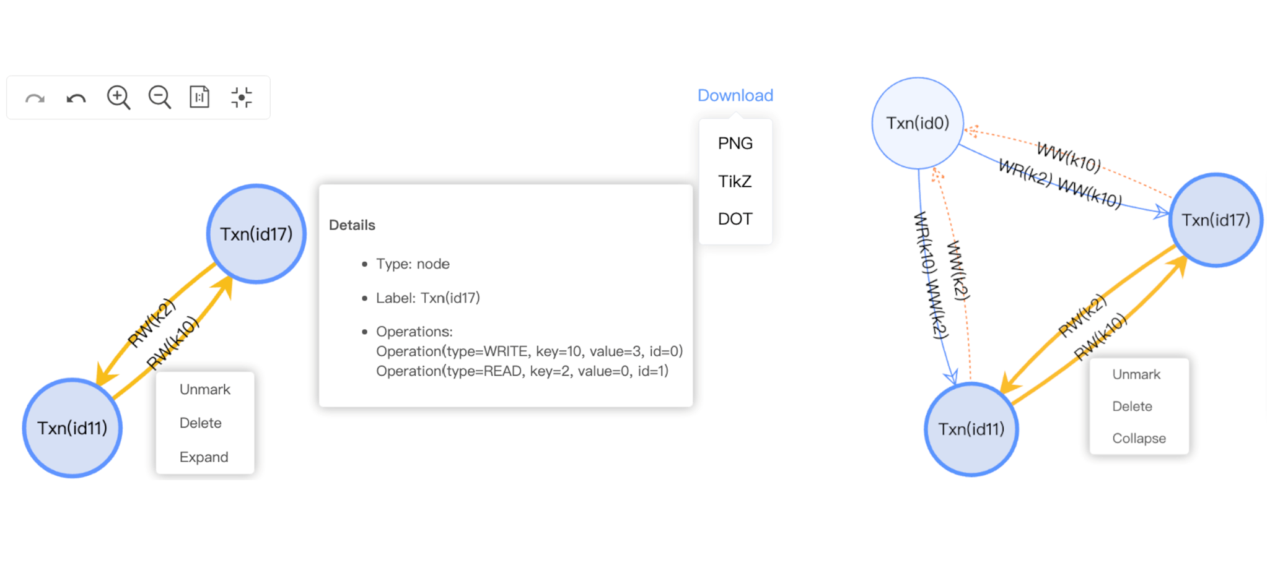
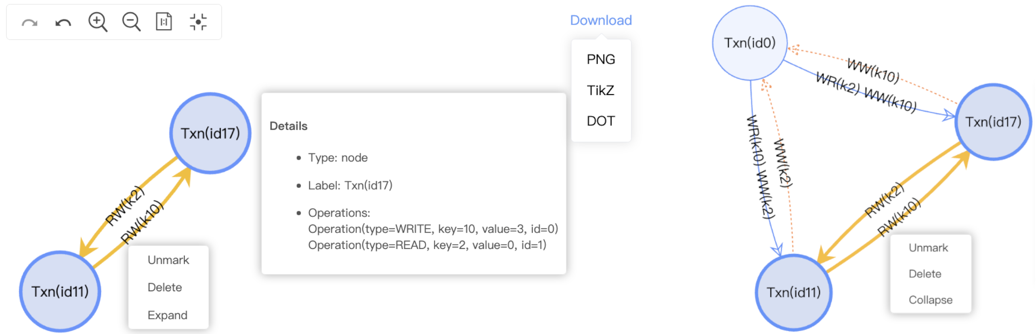



IsoVista: Black-box Checking Database Isolation Guarantees
Long Gu¹, Si Liu², Tiancheng Xing¹, Hengfeng Wei¹, Yuxing Chen³, David Basin²
¹ State Key Laboratory for Novel Software Technology, Nanjing University; ² ETH Zurich; ³ Tencent Inc.
Introduction
Key Features:
Support for Multiple Isolation Levels: IsoVista checks a broad range of isolation levels, including RC, RR, RA, TCC, SI, and SER.
Sound and Complete Checking: IsoVista uncovers real bugs and does not miss bugs.
Efficient Checking: IsoVista uses optimized SMT encoding and efficient data structure to improve checking efficiency.
Informative Bug Visualization: IsoVista provides detailed visualizations of bugs, aiding in bug understanding and debugging.
Benchmarking and Performance Profiling: IsoVista monitors runtime metrics and profiles checking performance.
Transactional isolation is critical to the correctness of Database Management Systems (DBMSs). IsoVista is a black-box isolation checking system for databases that supports various isolation levels, ensures accurate and efficient bug detection, provides clear bug visualizations, and offers benchmarking for performance analysis. It is designed to comprehensively test and verify the isolation guarantees of databases, helping developers to find and fix issues more effectively.
Demonstration
Configuration
Task Tracing
IsoVista provides a modular interface for developers to configure experiments. Both generated and pre-collected workloads are allowed.
IsoVista manages and displays task runs and bug summaries. Developers can track task status, view runtime details, and categorize detected isolation bugs.
Runtime and Checking Statics
Bug Visualization
IsoVista monitors CPU and memory usage, provides detailed performance metrics, and performs decomposition analysis.
IsoVista visualizes detected bugs as transactional dependency graphs. Developers can “Expand” edges to understand how they are inferred.
Contact
Long Gu, 502023320005@smail.nju.edu.cn
Hengfeng Wei, hfwei@nju.edu.cn

